Slide 1
MEMBERSHIP TYPE ANALYSIS
PRESENTED BY: ISHA DESAI
LAST UPDATED: 10/12/22

Slide 2
Table of contents
OBJECTIVES OF THE ANALYSIS
INSIGHTS DERIVED:
RIDE LENGTH COMPARISON
NUMBER OF RIDES COMPARISON
GENDER REPRESENTATION IN THE EXISTING MEMBERS
START STATIONS POPULAR IN CASUAL RIDERS
END STATIONS POPULAR IN CASUAL RIDERS
CONCLUSION

Slide 3
OBJECTIVES
Understanding the difference between casual riders and riders with annual membership.
1
Analyzing the population type less likely to choose an annual membership.
2
Discussing how the casual riders can be converted to members.
3

Slide 4
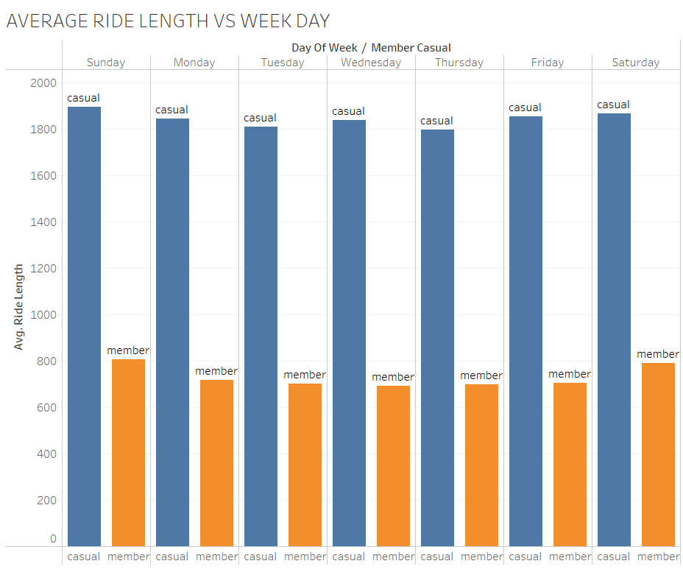
Ride length comparison:
The data is based on the days of week over the year 2016.
Throughout the week, the ride length of casual riders is consistently more than that of the customers with a membership.

Slide 5
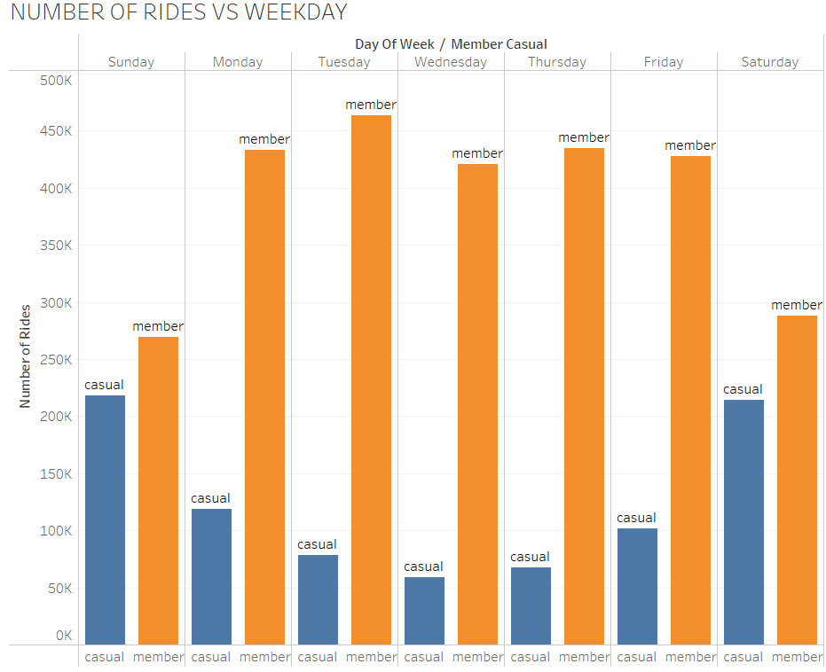
NUMBER OF RIDES COMPARISON
The people with a membership tend to use the bicycle more number of times.
Thus the casual riders are not very frequent users.

Slide 6
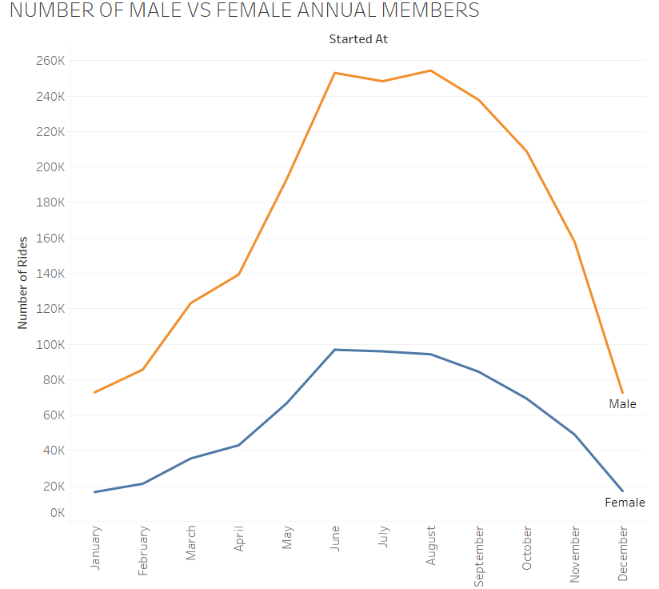
Gender representation in the existing members
Less women are likely to get an annual membership.
Further research is needed to determine if more women are preferring single-ride or full-day passes.

Slide 7
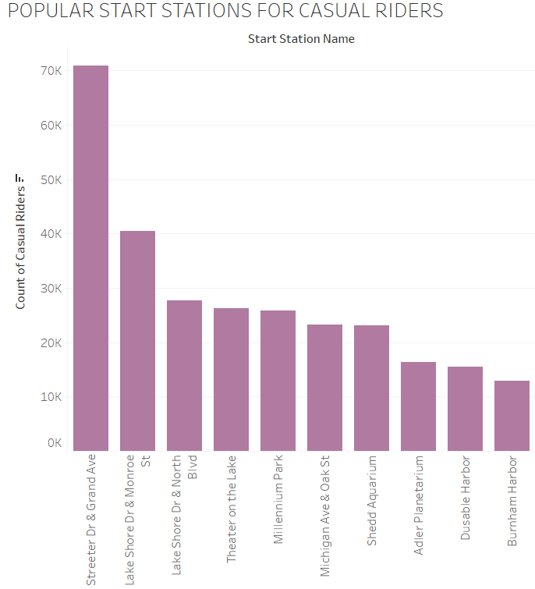
START STATIONS POPULAR IN CASUAL RIDERS
Start stations like Streeter Dr & Grand Ave, Lake Shore Dr & Monroe St, Lake Shore Dr & North Blvd etc. are more popular among the casual riders.

Slide 8
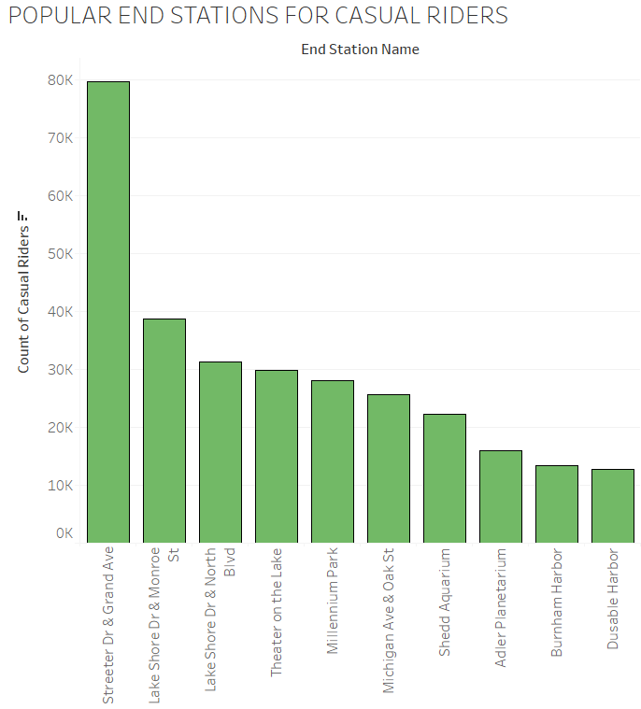
END STATIONS POPULAR IN CASUAL RIDERS
End stations like Streeter Dr & Grand Ave, Lake Shore Dr & Monroe St, Lake Shore Dr & North Blvd etc. are more popular among the casual riders.

Slide 9
conclusion
Casual riders are more likely to travel on a few days, but use the bicycle for a long ride.
Female riders appear to be less likely to get an annual membership. Additional policies for women riders might improve the situation.
Data related to the gender of casual riders will help to further improve the decision making, for increasing the number of women who are annual members.
There are a few start and end stations that are preferred by most casual riders. Discounts on memberships for the riders between these stations might boost the membership numbers.

